Slide 1


Tzedakah:
The Dental ALMS Foundation

Slide 2


Slide 3

About The Dental ALMS Foundation
Company: Tzedakah:
The Dental ALMS Foundation
Owner: Alfred L. Martinez
Industry: Dental Education
Notes:
Owner: brief background/experience/skills and expertise

Slide 4
Problem Statement
Movies, video games, apps and other forms of entertainment make old and most current forms of education outdated. New, engaging and relatable means of instruction are needed to captivate young minds.

Slide 5
Products
Dental Education Package:
Teaching dental hygiene, healthy eating, morals, values, work ethic and encouraging a desire to learn.
Dental Magazine
Comic Book
App educating on dental decline, behavior and teeth brushing reminders
Martial arts program, proper brushing techniques, 3D animated video program on dental health decline
Professional Education Package and Licensing for Dental Schools, Government Programs and Dentists

Slide 6
How am I different?
Characters (Trademarked)
Curriculum (Patented)
Content (Copyrighted)

Slide 7
Current Achievements
Characters
Curriculum
Content
Social Media
Team Building

Slide 8


Slide 9






Slide 10


Slide 11


Slide 12
An educational, factually correct, comic based on a dental theme
Entertaining
Martial Arts
Comedy
Dental Education
Healthy Eating
Moral Values

Slide 14
Characters

Slide 15
Three Superheroes
Seven Villains
Mad Scientist
Dog

Slide 16
Superheroes

Slide 17
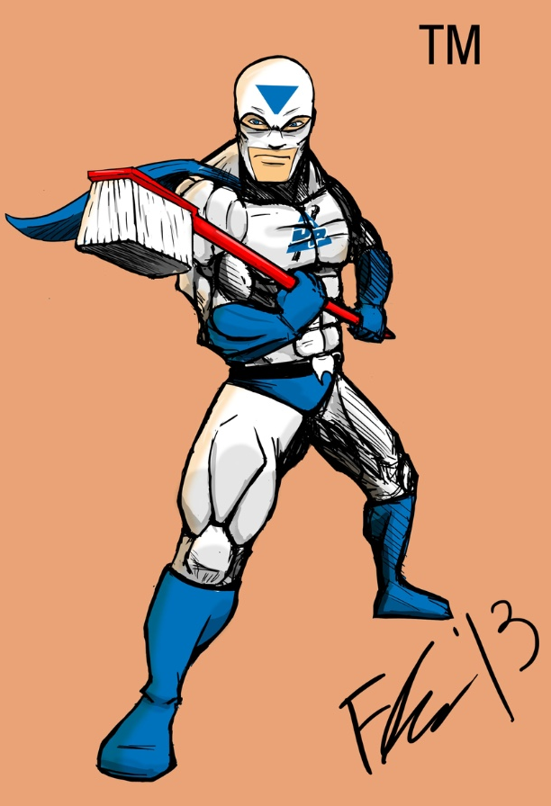
Dental Perfectionman

Slide 18
Perla Blanca

Slide 19
Ortho

Slide 20
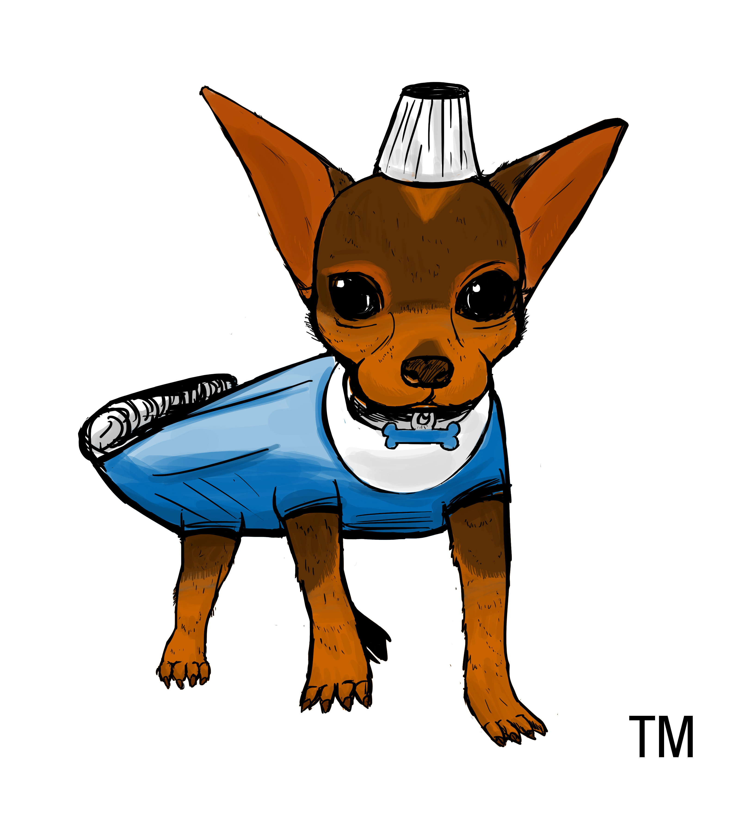
Anti

Slide 21
Villains

Slide 22
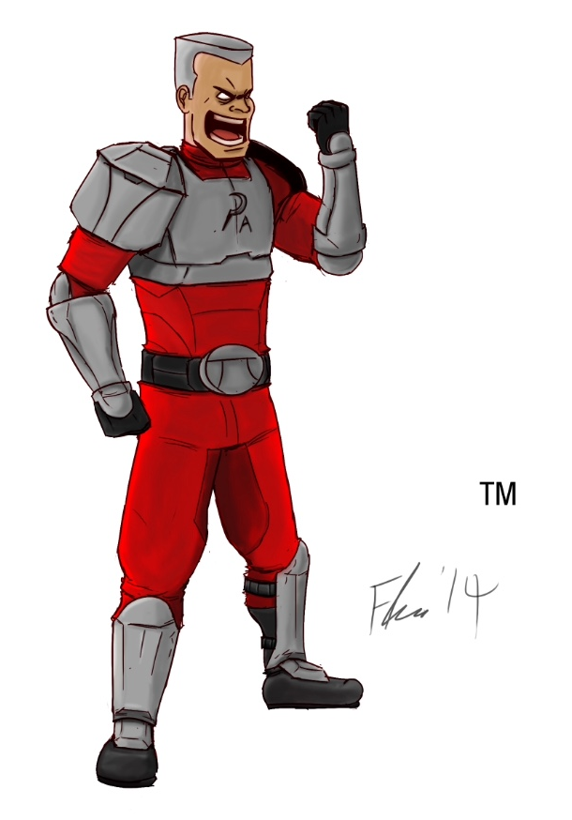
Plaque Attack

Slide 23
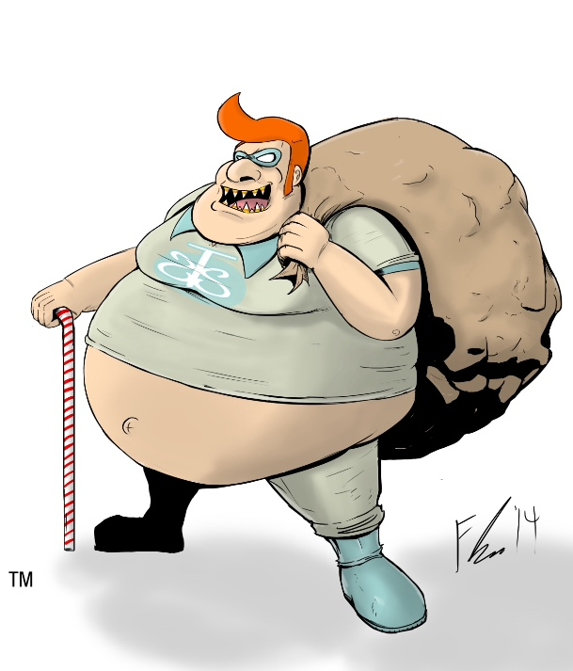
Sweet Tooth Sam

Slide 24

aCIDic

Slide 25
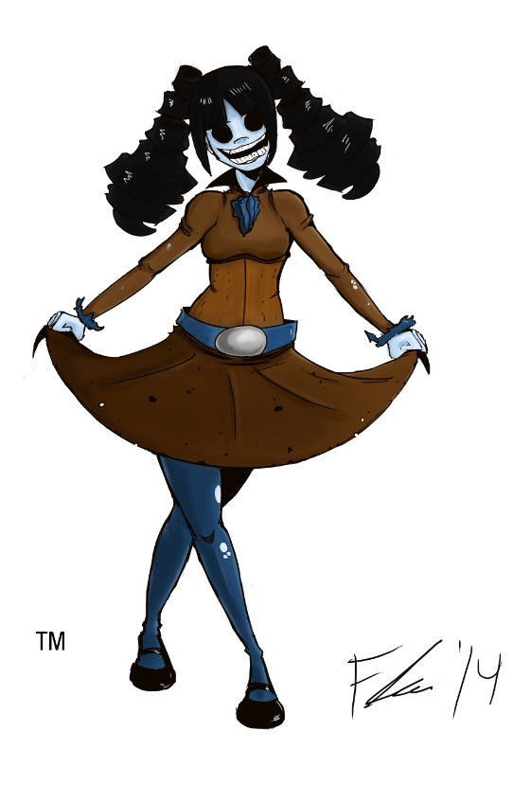
Cathy Cavity

Slide 26
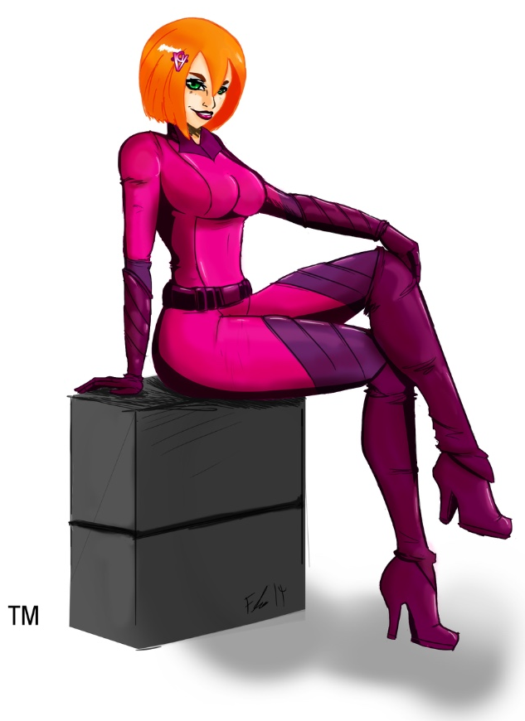
Ginger Vitis

Slide 27
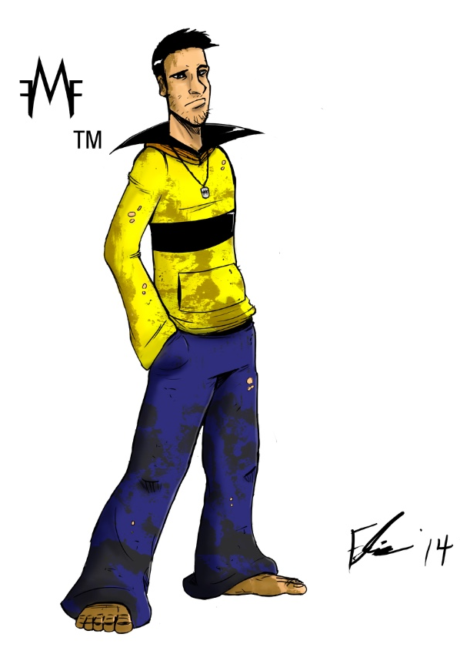
Foul Mouth Frank

Slide 28
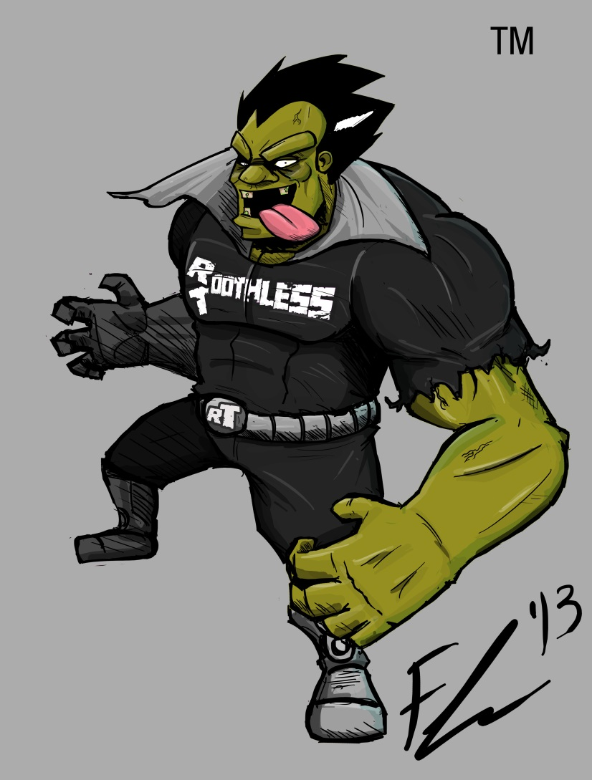
Roothless Toothless

Slide 29

Dr. Racuza

Slide 30
Educational App

Slide 31
App
Dental Education
Moral Education
Tooth Brushing Reminder
(Twice a day)

Slide 32
Upcoming activities
+Enter Incubation Program
+Enter The Genesis Generation Challenge
Develop App With iCORE
Create Marketing/Fundraising Video
Utilize Crowd Funding Platforms
Seek Grant Funding/Sponsors/Investors
Hold Networking/Fundraising/Media Event

Slide 33
Future Plans
App
Web Channel
Interactive Professional Tools
Promotional Products (Online Store)
Costumes
Video Games
3D Animated Cartoon
3 Full-Feature Films

Slide 34
THANK YOU

